Slide 1
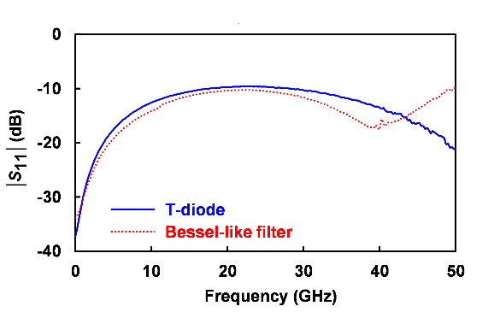
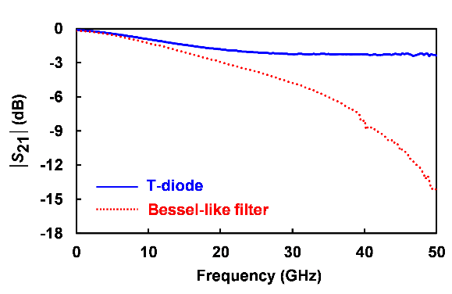
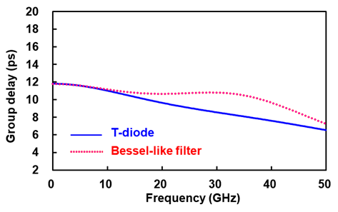
28 Gbps ESD Protection Circuit using Bessel-like filter in 28nm CMOS Process
Kunhee Park, Jihyeon Lee, Hyungeun Kim and Jinho Jeong
Department of Electronic Engineering, Sogang University
E-mail : when1280@naver.com, dlwlgus961@naver.com, lcksasin9@sogang.ac.kr, jjeong@sogang.ac.kr
Introduction
ESD(Electrostatic Discharge): Electrostatic stress that can be fatal to CMOS IC chips
The ESD device’s parasitic capacitance will cause the signal loss at gigahertz bands
T-diode I/O circuit, Bessel-like filter I/O circuit was designed in Samsung CMOS 28 nm FDSOI technology
ESD I/O design
L₁ = L₂ (pH) | C_{ESD} (fF) | k | C_{B} (fF)
220 - 288 | 300 | 0.3 - 0.7 | $$\frac{1−k}{1+k}\frac{CESD}{4}$$
L₁ (pH) | L₂ (pH) | C_{ESD1} (fF) | C_{ESD2} (fF) | C_{ESD3} (fF)
200 | 221 | 110 | 80 | 110
T-diode demonstrates a wide 3-dB bandwidth of |S₂₁| exceeding 50 GHz, whereas the 3-dB bandwidth of the Bessel-like filter is narrower, at 21.5 GHz
|S₁₁| of the Bessel-like filter remains below -10 dB over a wide bandwidth exceeding 50 GHz
Bessel-like filter demonstrates flatter group delay variation up to Nyquist frequency (= 14 GHz)
(a) (b)
Schematic of (a) T-diode I/O scheme and (b) Bessel-like filter I/O scheme
Diode’s parasitic capacitance is 300 fF to sustain 2 kV HBM stress
Simulation and measurement results
(a) (b)
Measured psuedo eye test results of (a) T-diode and (b) Bessel-like filter
 | Eye height (mVpp) | Eye width (ps) | Eye opening (=eye height $×$ eye width)
T-diode | 409 | 35.54 | 14.54 pV$∙$sec
Bessel-like filter | 426 | 35.71 | 15.21 pV$∙$sec
Eye opening is defined by the product of eye height and width
Despite having a wide 3-dB bandwidth, the T-diode exhibits relatively small eye opening than Bessel-like filter
Measured result indicates wide bandwidth as well as minimized group delay variation is required for wide eye opening
(a)
Conclusion
(b)
High speed I/O circuit operating at 28 Gbps data rate was designed, manufactured, and measured using CMOS 28 nm technology
The simulated results show that smaller group delay variance can improve eye opening considered with bandwidth
Measured S-parameters of T-diode and Bessel-like filter
Measured group delay of T-diode and Bessel-like filter
 | $\left|S_{11}\right|$bandwidth $(<−$10 dB) | 3-dB bandwidth ($\left|S_{21}\right|$) | Group delay Ripple up to 14 GHz
T-diode | 21.5 GHz | >50 GHz | 2.7 ps
Bessel-like filter | >50 GHz | 17.6 GHz | 2.5 ps
Acknowledgement
The chip fabrication and EDA tool were supported by the IC Design Education Center(IDEC), Korea.
Reference
In order to minimize ISI(Inter symbol interference), the $\left|S_{11}\right| bandwidth(<−$10 dB) must be secured to Nyquist frequency and 3-dB bandwidth must be at least 70% of the data rate [1]
B. Razavi, “The Design Of Broadband I/O Circuits [The Analog Mind],” IEEE Solid-State Circuits Magazine, vol. 13, no. 2. Institute of Electrical and Electronics Engineers (IEEE), pp. 6–15, 2021.

